Slide 1
HDFS vs Relational Database – A Performance Comparison
By
Victor Sankar Ghosh (vsg23)
Sai Revanth Tummala (st1109)

Slide 2
Agenda
Hadoop Distributed File System
Performance Analysis with Relational DBs
Final Takeaways

Slide 3

Hadoop Distributed File System
What is HDFS ?
Components of HDFS
Apache Spark

Slide 4
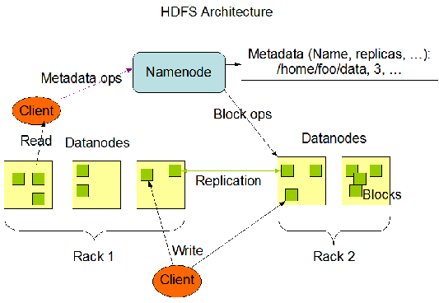
What is HDFS ?
HDFS, or the Hadoop Distributed File System, is a distributed file system designed to store very large data sets reliably, and to stream those data sets at high bandwidth to user applications. It's a core component of Apache Hadoop, which is an open-source framework used for distributed storage and processing of big data using the MapReduce programming model.

Slide 5
Components of HDFS
Hadoop HDFS - Hadoop Distributed File System (HDFS) is the storage unit of Hadoop.
Hadoop MapReduce - Hadoop MapReduce is the processing unit of Hadoop. This software framework is used to write applications to process vast amounts of data.
Hadoop YARN - Hadoop YARN is a resource management component of Hadoop. It processes and runs data for batch, stream, interactive, and graph processing - all of which are stored in HDFS.

Slide 6
Apache Spark
Apache Spark is a powerful, open-source data processing engine designed for fast computation. It's part of the broader Hadoop ecosystem and can run on Hadoop's Distributed File System (HDFS) as well as other data storage systems.
Using Spark with HDFS is particularly effective for organizations that already have Hadoop clusters and are dealing with large-scale data storage and processing needs. Spark enhances the capabilities of HDFS by providing faster processing speeds, ease of use through its APIs, and the ability to handle a wide variety of workloads effectively. This combination allows organizations to derive insights and process data at scale efficiently, making the most out of their existing Hadoop infrastructure.

Slide 7
Performance Analysis with Relational DBs
Sample Data Used
Environment Setups
Real-World Timings

Slide 8
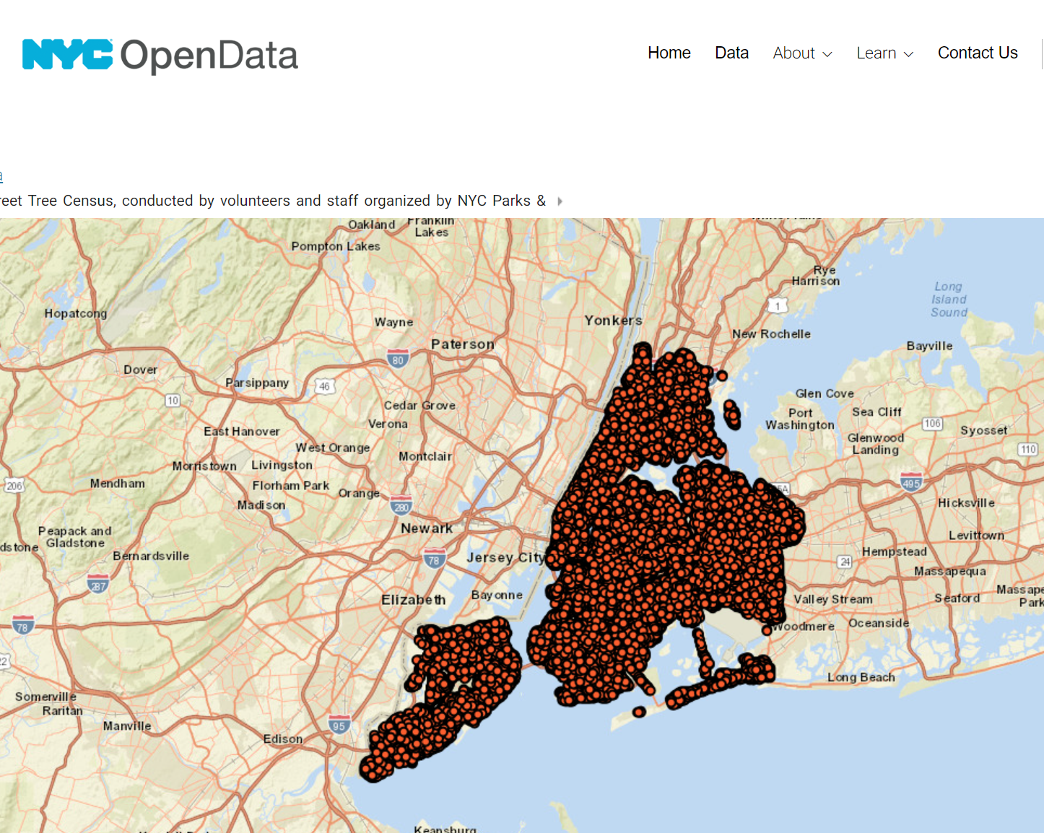
Sample Data Used
For sample data, we used the
NYC 2015 Street Tree Census Report
The size of this data is 236MB and is in CSV format

Slide 9
Environment Setups
HDFS Setup:
HDFS version : 3.4.0
Apache Spark & PySpark (for Data Processing)
Relational Database:
MySQL WorkBench 8.0

Slide 10
Real-World Timings
 | Loading Data to DB | Read Data | Update Data | Truncate Data
HDFS | 6.163386 sec | 3.630672 sec | 1:08.25047 mins | 0.29 secs
Relational Database | 15.359 sec | 3.734 sec | 1:19.203 mins | 0.031 sec

Slide 11

Experiment Shortcomings
Bulk of the experiment has taken on WSL on Windows
Only single node has been used for HDFS
Nodes were virtually simulated

Slide 12
Final takeaways
When to use HDFS:
Handling Big Data
High Throughput is required
Write Once, Read Many
Data Variety
When to use Relational Database:
Transaction Support
Structured Data with Complex Queries
Real-Time Data Access
Low Data Size
Mature Tools and Ecosystem
Notes:
Choosing between the Hadoop Distributed File System (HDFS) and a relational database depends largely on the nature of your data and your specific use case. Here’s a guide to help you decide:
### Use HDFS When:
1. **Handling Big Data**: If you're dealing with massive volumes of data (in the order of petabytes or more) that is too large for a traditional database to manage efficiently, HDFS is designed to handle such scales.
2. **High Throughput**: For applications requiring high throughput access to data, especially for large files, HDFS can be more suitable because it's designed to support large data sets with streaming data access patterns.
3. **Write Once, Read Many**: HDFS works well for scenarios where data is written once and read many times. It is optimized for batch processing, where data is appended and rarely updated.
4. **Fault Tolerance**: HDFS is designed to be fault-tolerant by replicating data across multiple nodes. This redundancy can handle failures without data loss.
5. **Data Variety**: If you are processing unstructured or semi-structured data, such as text, images, or video, HDFS can be more flexible compared to the structured nature of relational databases.
### Use Relational Database When:
1. **Transaction Support**: If your application requires complex transactions, such as updates, deletes, and referential integrity, relational databases provide robust transaction support and ACID (Atomicity, Consistency, Isolation, Durability) properties.
2. **Structured Data with Complex Queries**: Relational databases are ideal when you need to perform complex queries on structured data. They are optimized for fast query performance and are able to efficiently execute SQL queries involving joins, aggregations, and sub-queries.
3. **Real-Time Data Access**: For applications requiring immediate, real-time access to data (like online transaction processing systems), relational databases provide low latency data access that HDFS cannot.
4. **Data Size**: If your data volume is relatively moderate and does not require the massive scalability offered by HDFS, a relational database might be more practical and cost-effective.
5. **Mature Tools and Ecosystem**: Relational databases have a mature ecosystem with extensive tools for data management, reporting, and analytics.
### Hybrid Approaches:
In some cases, a hybrid approach might be suitable. For instance, storing raw data in HDFS for batch processing and aggregating results in a relational database for quick querying and reporting. This combines the strengths of both systems according to different needs within the same application or suite of applications.
By considering these factors, you can better determine which system is more appropriate for your specific requirements.

Slide 13
Thank you

